Slide 1



Software Defined Network Controller

Slide 2
Agenda
Overview
Architecture
Directed Graph & Service Logic Interpreter(SLI)
Design Time/Runtime Flow
APIs and External Interactions
Adaptors
Local setup using docker-compose
Debugging/logs
Code Repo
Implementation details

Slide 3
SDNC - Introduction
https://docs.onap.org/en/latest/guides/onap-developer/architecture/onap-architecture.html
The SDN-C project provides a global network controller, built on the Common Controller Framework, which manages, assigns and provisions network resources. The project also supports the ability to invoke other local SDN controllers, including third party SDN controllers

Slide 4
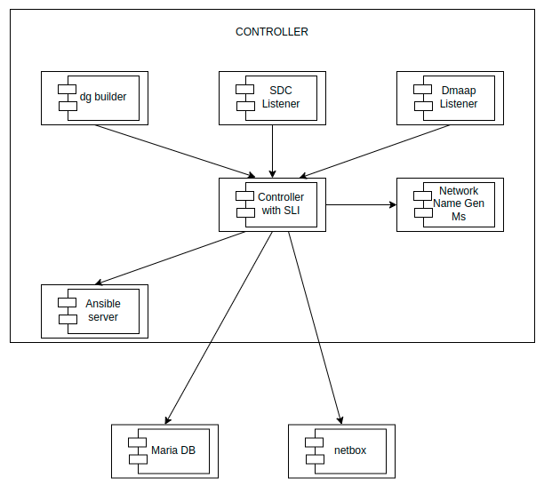
SDNC Architecture
https://wiki.onap.org/pages/viewpage.action?pageId=117739437
DG Builder Container - Design Time
DGBuilder refers to graphical tool to create DG’s
SDC Listener Container - Run Time
Interface to receive resource templates from SDC design catalog
DMAAP Listener Container - Run Time
Listener for event notifications
Controller (ODL) Container with SLI - Run Time
Open source SDN controller platform. Within this framework the Service Logic Interpreter (SLI) is in charge to check if a DG exists, get it from the SDNC Database and execute it.
Network Name Gen MS Container - Run Time
Network element name generation microservice generated unique names for network elements such as VNF, VM, VNFC etc based on policies in the policy manager.
Ansible Server Container
Ansible is one of the configuration mgmt tool. Ansible Server is web server which exposes rest interface and executes ansible playbooks
MariaDB Galera - Platform Service
Netbox - Platform Service
Netbox is Ip address management platform. It is used by CDS to assign Ip address to resources.
Based on ODL

Slide 5
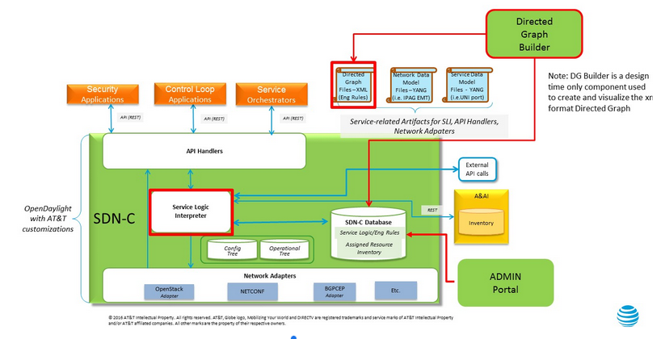
SDNC SLI Architecture (built over ODL)
https://wiki.onap.org/pages/viewpage.action?pageId=3247281
DG Builder
Graphical tool to create DG.
API Handler
NBI exposes several RESTCONF APIs
The API handlers is the component responsible to handle received API requests and delegate the execution workflow to SLI.
Service Logic Interpreter
Execution engine for DG.
Adaptors
Southbound interface is made up of Java plugins (adapters) to interact with the underlying domains/networks with different protocol/mechanism.
Adaptors available currently are Ansible, Chef, SaltStack, Rest, SSH, Netconf, Restconf, Netbox client etc
Notes:
sdfdsfsdfdsfds

Slide 6
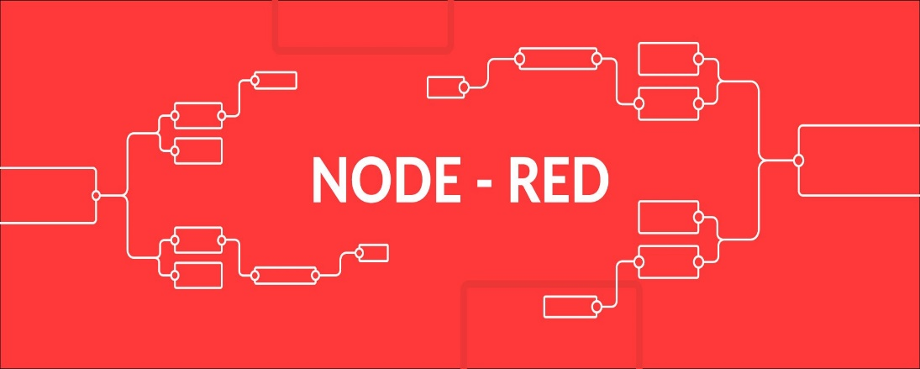
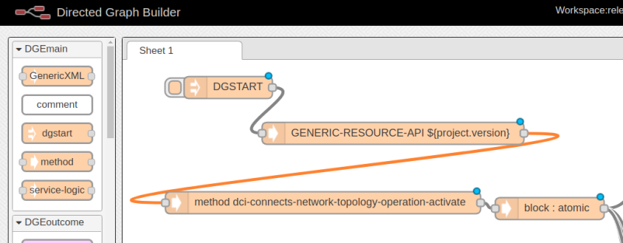
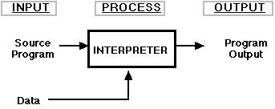
DG-SLI - Introduction
DG is short for Directed Graph, It is built on top of IBM’s Node Red.
DG builder refers to the graphical tool for creating a DG.
A DG is the actual graph which is an instance of a service flow and generates an XML for use by the Service Logic Interpreter(SLI).
SLI stands for Service Logic Interpreter.
SLI is a piece of java code written in house
SLI executes corresponding DG @ Runtime for a given Data.

Slide 7
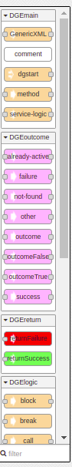
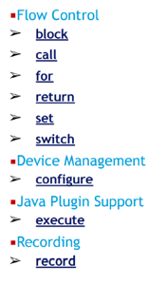
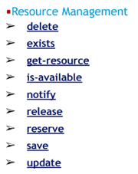
DG Builder - Service Logic Nodes
Node for all programming needs.
Flow control to write logic.
Resource nodes for DB operations. It could be AAI or any SQL database or MDSAL’s data store
JAVA Plugin node to write re-usable logic as JAVA code and use it from DG.
Record node for logging.
Extensible framework allow addition of new nodes, plugins, resource adapters etc.

Slide 8
DG Builder - Service Logic Nodes
DG start : This node starts a flow. This node is required on every flow. This node has a button to its left, when clicked generates the XML for the flow.
Service logic : DG start node is followed by service logic node where we configure module name and version.
Method : RPC name will be configured in method node. Service logic’s module name and rpc in method’s node is key to identify any DG.
Block: A block nodes is used to execute a set of nodes.
Call : A call node is used to call another graph. Attributes are module name, rpc, version and mode.
Execute: An execute node is used to execute Java code supplied as a plugin. Attributes are Fully qualified Java class of plugin to be used and Name of method in the plugin class to execute. Method must return void, and take 2 arguments: a Map (for parameters) and a SvcLogicContext (to allow plugin read/write access to context memory). Java plugin must implement SvcLogicPlugin to be used in execute node.
Resource management nodes : Resources management nodes are save, update, delete etc. It is used to operate on DB. DB could be AAI/SQL/MDSAL. Attributes include fully qualified Java class of resource adaptor to be used, resource(type of resource), key (ex: SQL statements ). An adaptor must implement SvcLogicResource to be used in these nodes.

Slide 9
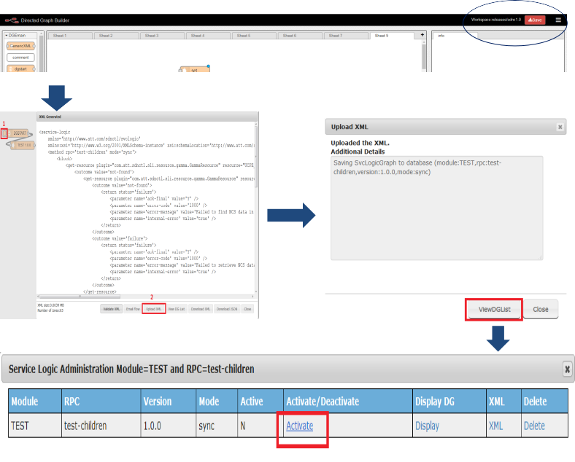
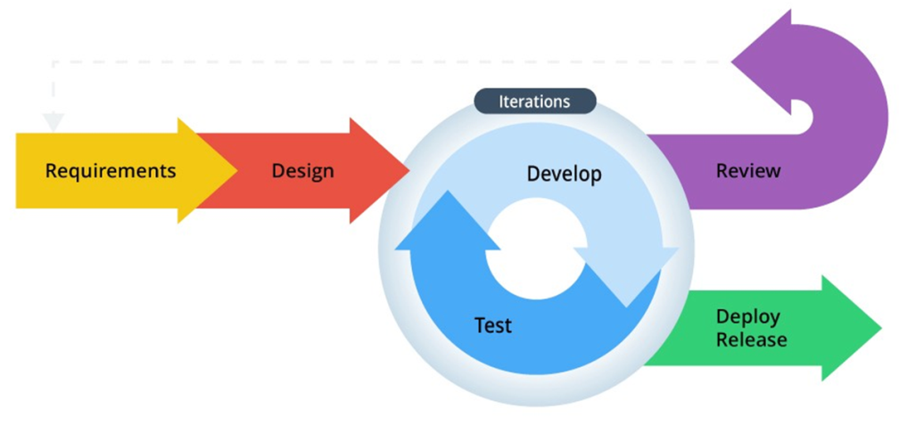


DG Builder - GUI
At runtime controller service logic can be changed just by modifying DG

Slide 10
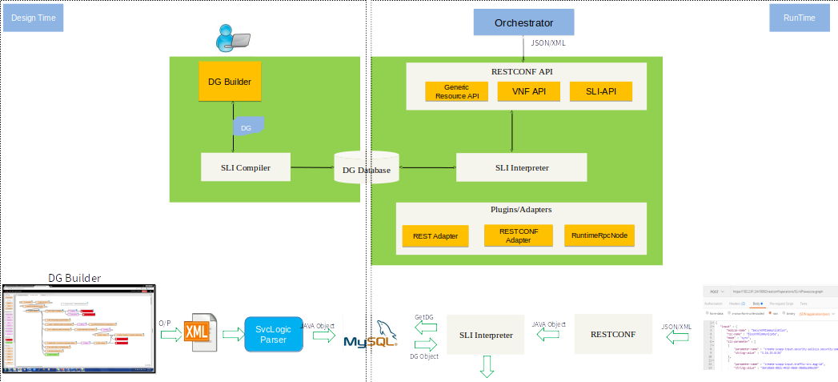
DG/SLI Design/Runtime - Flow

Slide 11
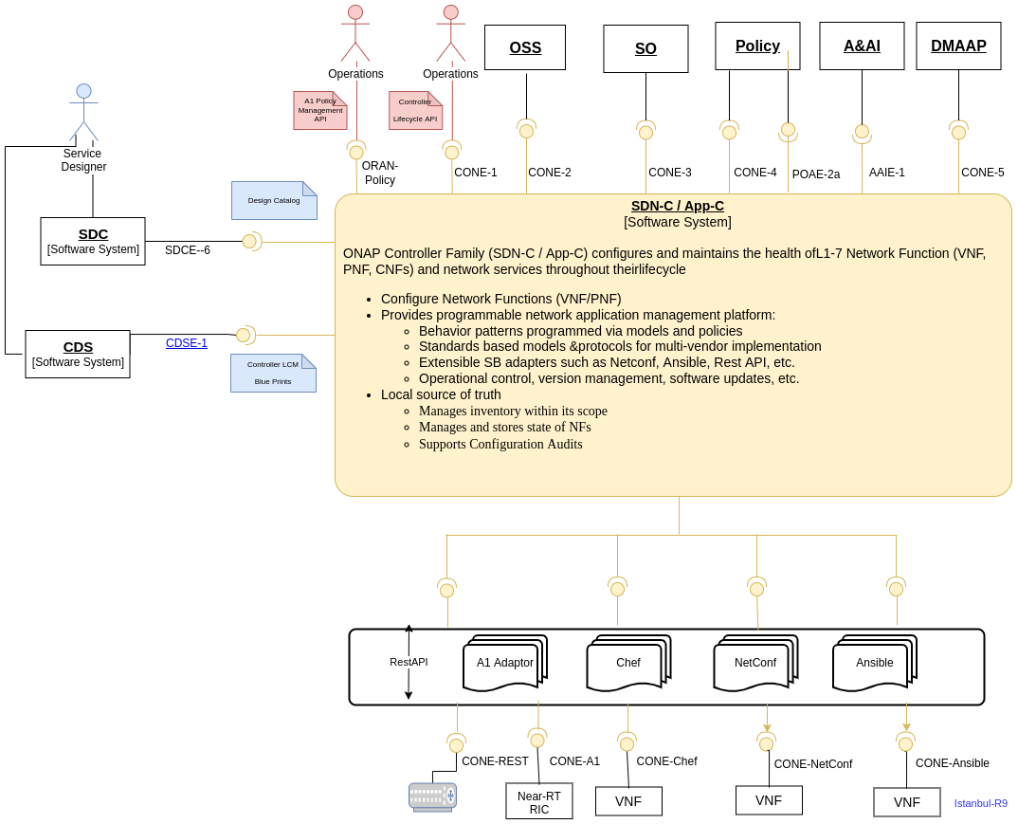
SDNC API & External Interaction
https://wiki.onap.org/pages/viewpage.action?pageId=117739437
The northbound interface is composed of several providers that expose a set of RESTCONF APIs.
Those APIs are used to interact with different components:
DMaaP, for event notifications;
SDC, for the distributions phase (receive and consume TOSCA models);
MSO, for orchestration workflow logic;
Policy for ,control loop applications.
AAI,for resource query & update
Northbound APIs are modelled via YANG and YANG-generated Java classes.
Southbound interface is made up of Java plugins (adapters) to interact with the underlying domains/networks with different protocol/mechanism.
The DG workflow defines the application logic and one or more plugins can be called.
Provider and plugin are uploaded in SDNC as bundle in the Opendaylight environment.
Adaptors currently implemented are ansible, Rest, Netconf, Restconf, SSH, Netbox Client etc

Slide 12
SDNC API & External Interaction(Incoming APIs)
Reference Point | API | Description | Swagger
CONE-3 | Service Order Interface (GENERIC-RESOURCE-API) | An interface to request for Configuration and Lifecycle management operations on network resources | GENERIC-RESOURCE-API swagger (yaml)
CONE-4 | Policy Interface SDN-C: LCM | An interface to support LCM requests such as Restart, Rebuild, Migrate, Evacuate operations on network resources | Swagger TBD - Interface format is the same as APP-C LCM (see ReadTheDocs)
CONE-5 | Data change event from AAI (DMaap) | An interface to notify on any change in AAI such as new domain controller added to AAI/ESR system
SDCE-6 | SDC Interface | An interface to receive resource Templates from SDC design catalog

Slide 13
SDNC API & External Interaction(Outgoing API)
Reference Point | API | Description
CONE-5 | Rest API | An interface for communication with external systems such as IP management
CONE-8 | Resource Ansible API | An interface for configuration and Lifecycle management of network resources using Ansible protocol
Other south bound adaptors | Restconf, SSH, Netbox client | An interface for communication with external systems
AAIE-1 | Inventory Service Interface | An interface to create, update, query, and delete resource information and relationships

Slide 14
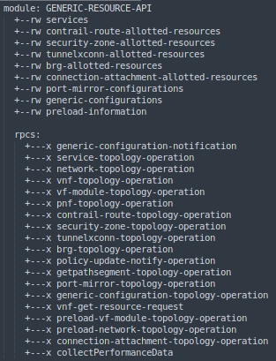
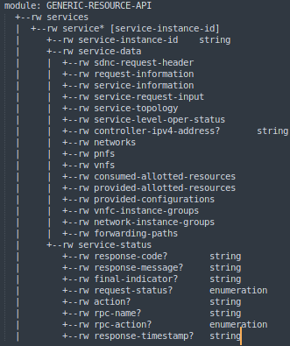
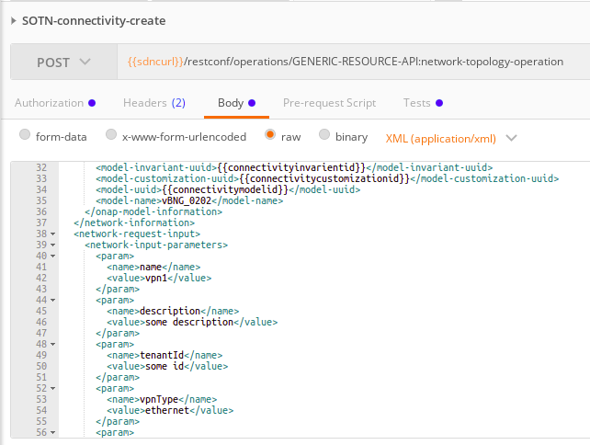
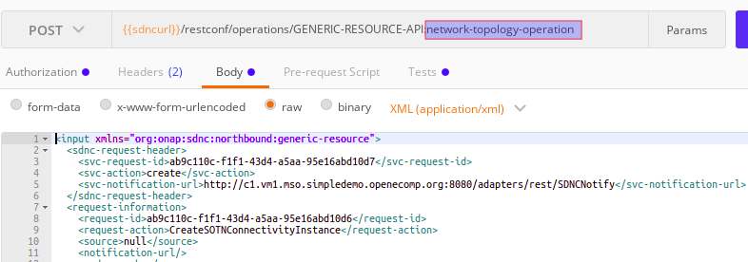
SDNC Generic-Resource-API Explained
https://wiki.onap.org/display/DW/Understanding+the+the+GENERIC-RESOURCE-APIs
An interface to request for configuration and Lifecycle management operations on network resources.
The GENERIC-RESOURCE-APIs are the rpcs described in the yang model GENERIC-RESOURCE-API.yang.
These APIs allow interaction with SDNC for generic services and resources where the payload is an array of name/value pairs that can be processed by SDNC DG
The service-topology-operation rpc is used to create/manager an initial service instance & other RPCs are create/manage resource inside service
service expanded in generic-resource-api.yang
Generic-resource-api-.yang
Payload in request
DG execution request.

Slide 15
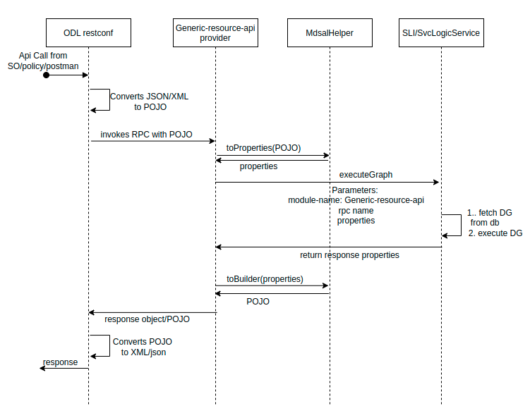
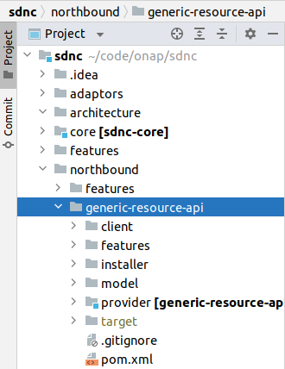
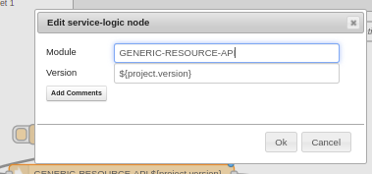
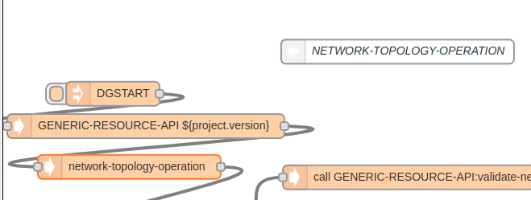
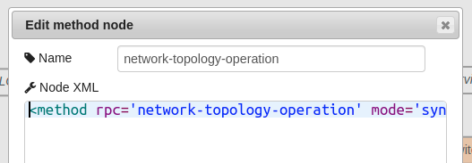
SDNC Generic-Resource-API Explained
https://wiki.onap.org/display/DW/Understanding+the+the+GENERIC-RESOURCE-APIs
The GENERIC-RESOURCE-APIs are the rpcs described in the yang model GENERIC-RESOURCE-API.yang (figure1).
GenericResourceApiProvider implements RPC’s defined in yang
For each RPC’s defined in yang, there is corresponding DG with same rpc name and module as GENERIC-RESOURCE-API as shown in Figure2.
When RPC is invoked(figure3), GenericResourceApiProvider calls SLI to execute DG based in RPC name as shown in figure4
Includes Yang file
RPC implementation
Figure4: DG execution flow
Code Structure
Figure1: Generic-resource-api-.yang
Payload in request
DG execution request.
Figure3: API call
Figure2: Generic resource api in DG.

Slide 16
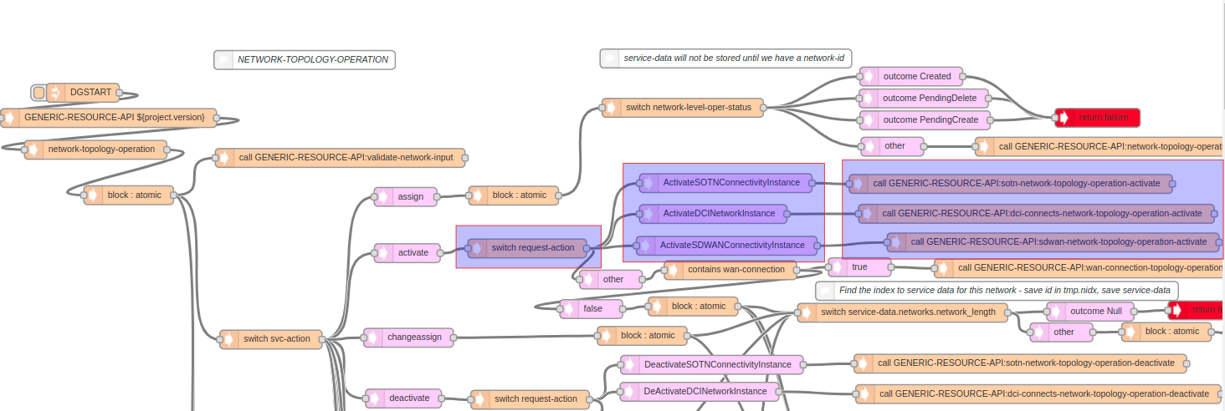
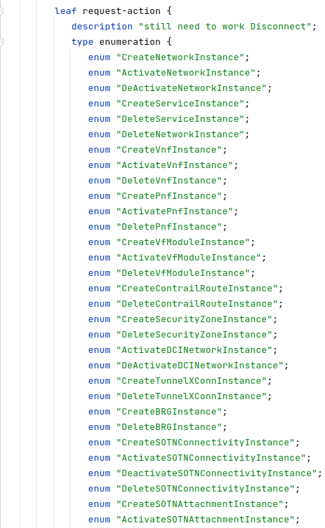
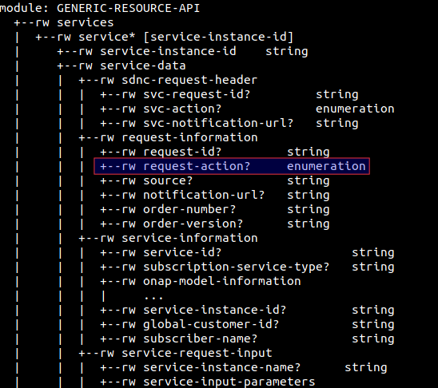
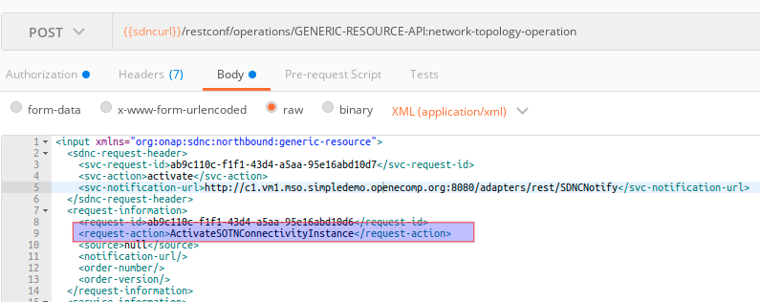
Service Logic (DG) Addition & Linking for New Resource
https://gerrit.onap.org/r/c/sdnc/northbound/+/57037/3/generic-resource-api/model/src/main/yang/GENERIC-RESOURCE-API.yang
New DG’s operating on new resource can be added by introducing new enum for request-action leaf in GENERIC-RESOURCE-API.yang as show in fig4
Request-action is of type enumeration(fig3), enum’s should be predefined in yang. Otherwise input request validation will fail.
Main DG(fig1) checks request-action input(fig2) and branches to new DG flow as shown in fig1
Fig1: Main DG is calling usecase specific DG based on request action
Fig4 : enums in request-action in generic-resource API.yang
Fig2: Input for request-action in API call
Fig3: request-action in generic-resource-api.yang

Slide 17
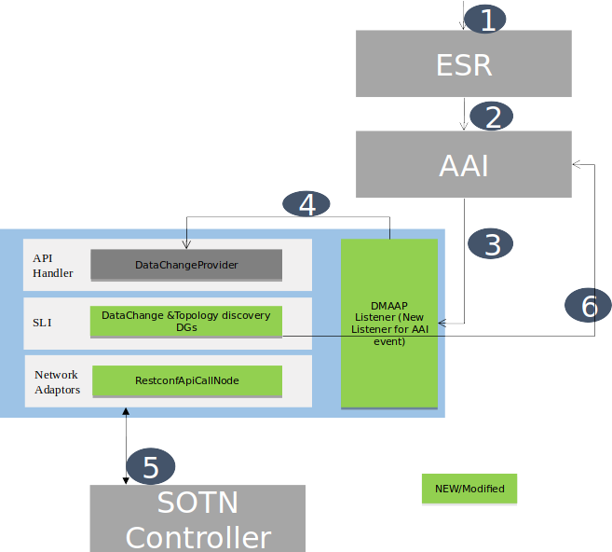
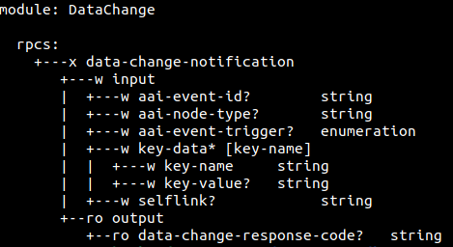
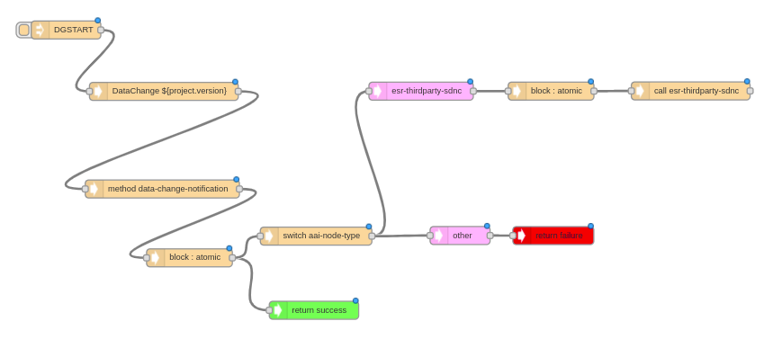
SDNC Data-Change-API Explained
User registers 3rd party controller information in ESR.
ESR adds 3rd party controller information in AAI.
AAI notify addition of 3rd party controller information to DMAAP Listener in SDNC.
DMAAP Listener in SDNC sends Data change request.
SDNC query topology from 3rd party Controller
SDNC adds topology to AAI
Physical Network Topology Onboarding Framework

Slide 18
Adaptors

Slide 19
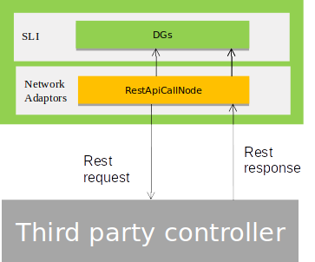
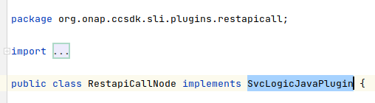
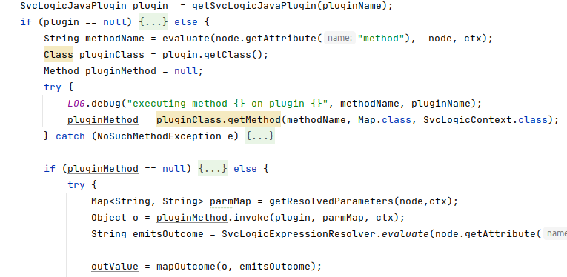
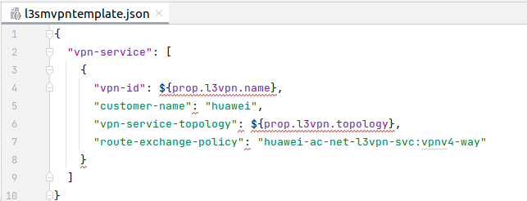
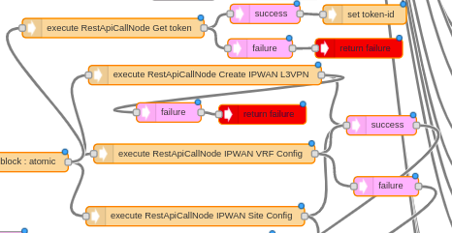
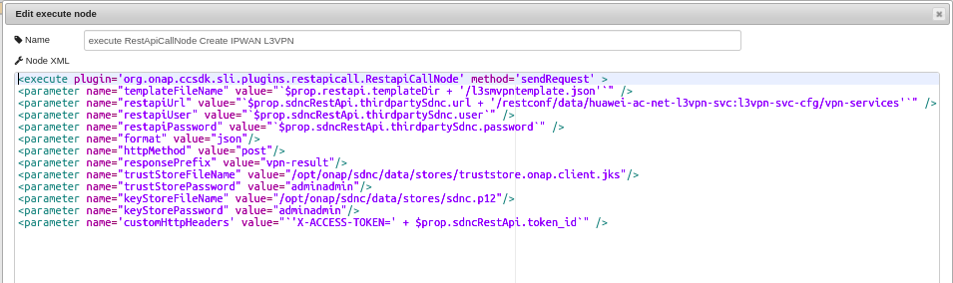
Plugins - RestApiCallNode
It is used to perform REST based CRUD operation on devices/3rd party controller
It is added as a SvcLogicPlugin and can be used from directed graphs using execute node
Developer has to create a template for request and template path to be provided in each request
Template file example
RestApiCallNode in DG
Parameters of RestApiCallNode

Slide 20
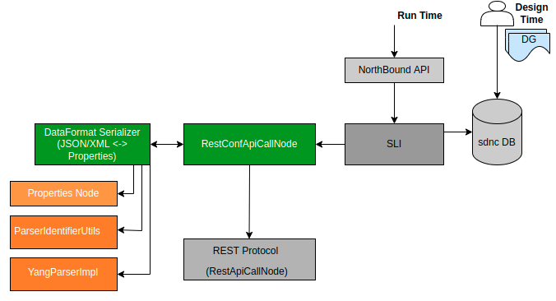
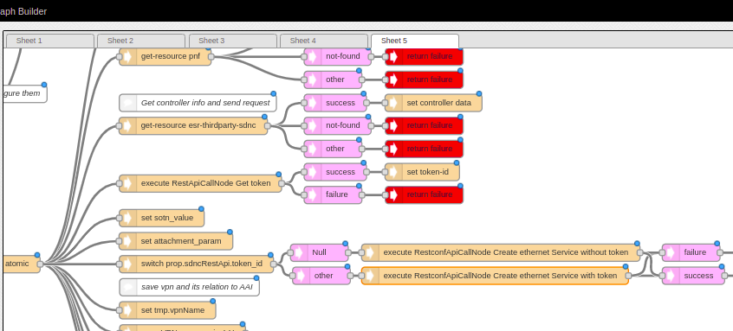
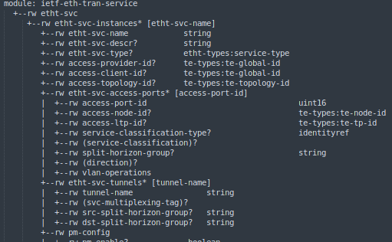
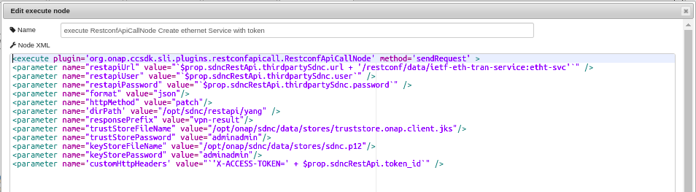
Plugins - RestconfApiCallNode
It is used to perform RESTCONF YANG based operation on devices/3rd party domain controller.
It is added as SvcLogicPlugin and can be used from Directed graph using execute node
It provides YANG guide serialization/deserialization.
Avoid need to write additional templates.
RestconfApiCallNode in DG
Sample yang file used to send request
Parameters of RestconfApiCallNode

Slide 21
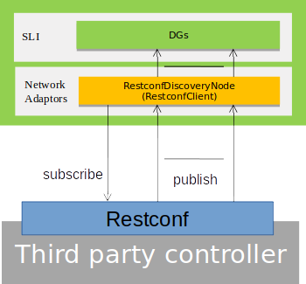
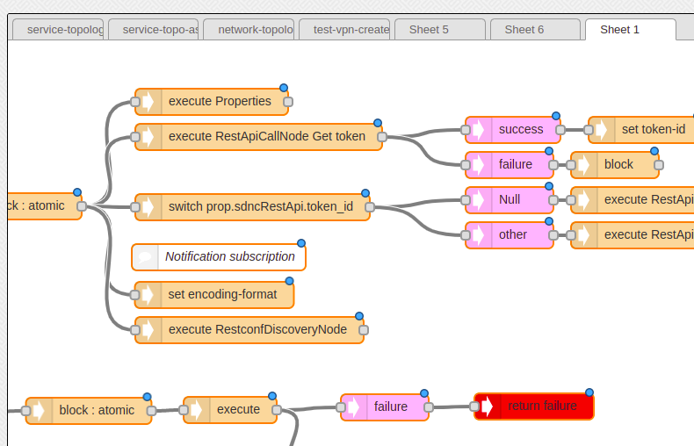
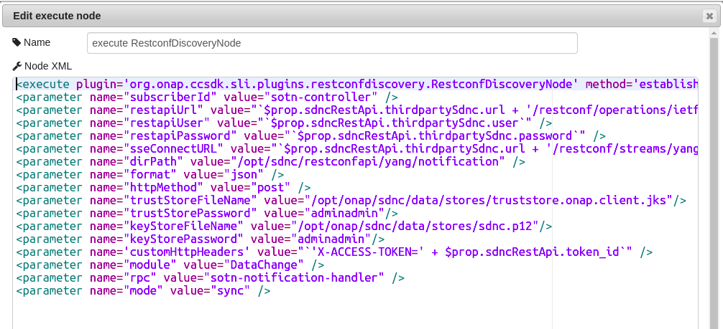
Plugins - RestconfDiscoveryNode
The RESTCONF protocol supports YANG-defined event notifications. The solution preserves aspects of NETCONF event notifications [RFC5277] while utilizing the Server-Sent Events transport strategy
Based on Pub/Sub mechanism.
Creates a persistent connection with Server.
For example, RestconfDiscoveryNode is used to fetch any change in topology from third party controller in ccvpn use case.
RestconfDiscoveryNode in DG using execute Node
Parameters of RestconfDiscoveryNode

Slide 22
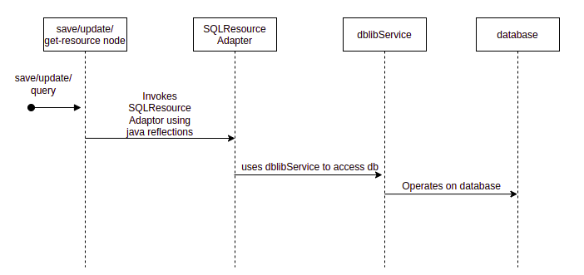
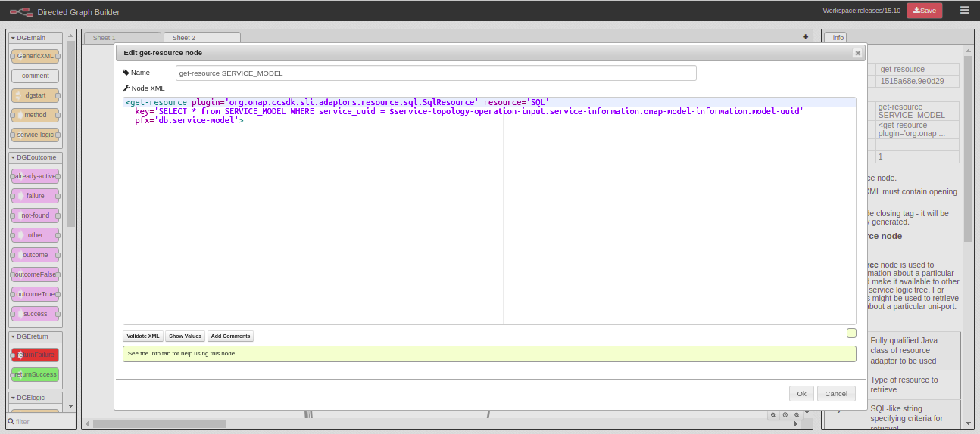
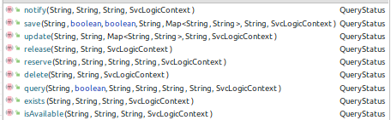
Adaptors - SQL Resource
SQL Resource provides interface to interact with SQL db.
It implements SvcLogic Resource and provides API’s such as save, query, delete, update etc
It can be used with any resource-management nodes in DG. for ex: get-resource node, save update etc
It uses sli/core/dblib service which internally used mariadb-jdbc to access db.
Parameters include
Plugin: fully qualified java class name of SQLResource, resource should be SQL
Key: SQL statement
Resource: SQL

Slide 23
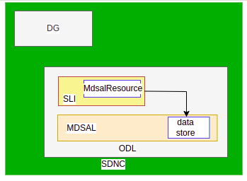
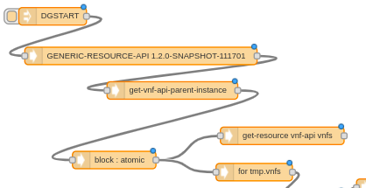
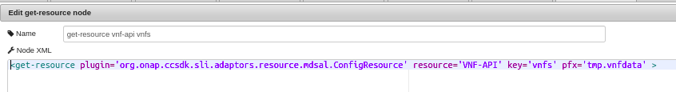
Adaptors - Mdsal Resource
https://docs.opendaylight.org/projects/mdsal/en/latest/index.html
MdSAL Resource provides interface to interact with ODL’s Config & operational datastore.
It implements SvcLogicResource and provides API’s such as save, query, delete, update etc
It can be used with any resource-management nodes in DG. for ex: get-resource node, save, update etc
It operates on MdSAL data store using Restconf.
Parameters include
Plugin: fully qualified class name of ConfigResource or Operational Resource
Resource: module-name
Key: container name

Slide 24
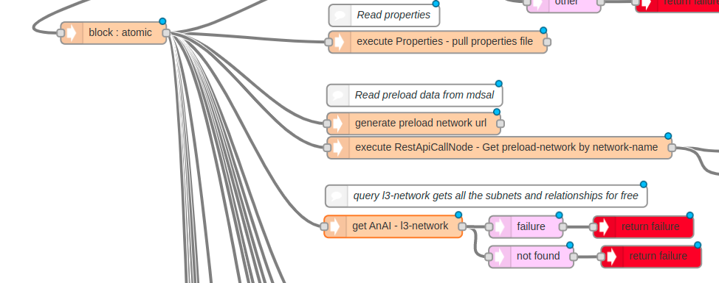
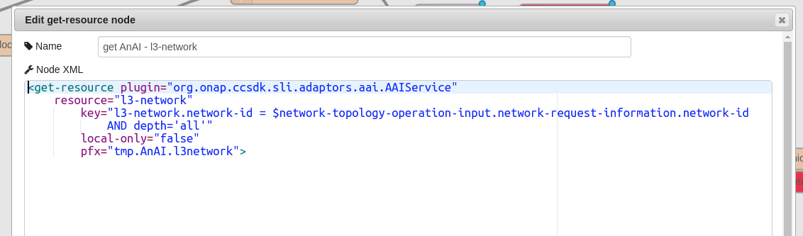
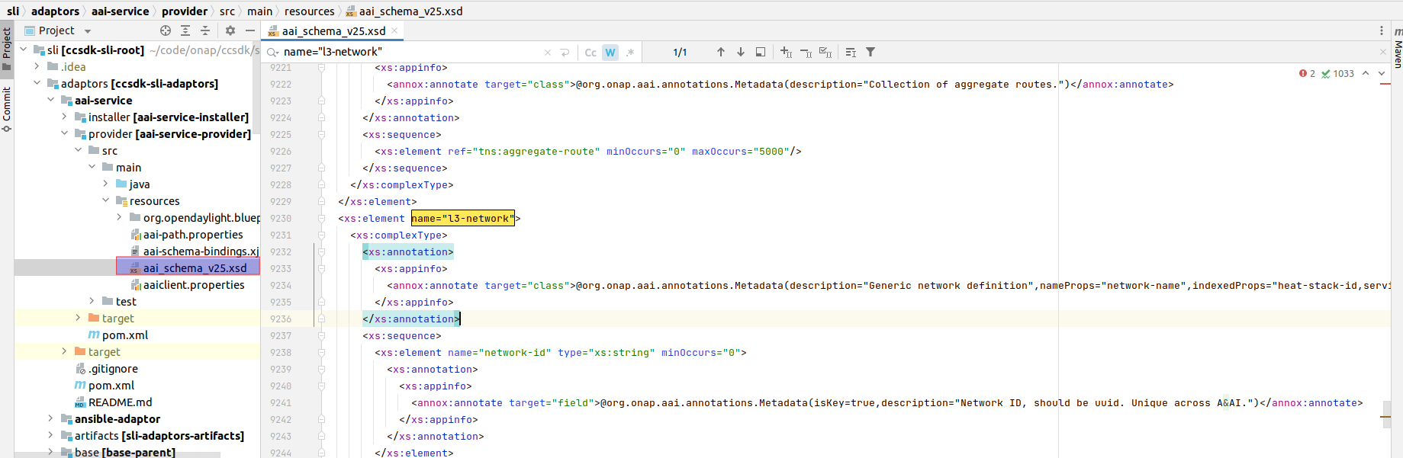
Adaptors - AAI Service
SDNC will read/write objects to A&AI using AAI service adapter
It is capable of reading/writing any object defined in A&AI XSD schema.
For any new resource, resource should be added in aai_schema_v25.xsd
AAIService will create rest request body based on schema defined in aai_schema_v25.xsd
AAIService uses restclient to interact with AAI.
The DG for the usecases will drive specific objects are read/written.
AAIService example in DG
Parameters of AAIService
aai_schema_v25.xsd

Slide 25



Adaptors - Ansible
An Ansible Server interface: Ansible libraries are written in python and hence cannot be executed natively from within the ODL Karaf container. Instead, the design calls for an Ansible Server that can execute the Ansible playbooks and exposes a REST interface
An Ansible adapter: The ansible adapter is an OSGI bundle in the container that interacts with the Ansible Server . It is essentially a set of REST calls that performs two actions, submit request for a playbook to be executed, and if required get the results of the playbook after execution (if in synchronous mode).

Slide 26

Adaptors/Plugins - Others(used by APPC/CDS)
Salt-stack adaptor (https://wiki.onap.org/display/DW/APP-C+Saltstack+Adapter)
Saltstack is a an open-source config management tool that can be used in VNF management framework that allows provide an almost cli like set of tools in a structured form.
Here Saltstack Server is called as salt master and clients are called as salt minions which run as agents in the client machine
Salt uses YAML config files, organized into templates or packages called states.
In the target VNF it is necessary to have a) an SSH server, b) salt minions and dependencies and d) any necessary software that is specific to the VNF to run its functions.
Many actions such as configure, restart, health check can be executed on the VNF by constructing a salt-states (set of sls files) that is executed by an Saltstack server on the VNF via SSH.
The Saltstack adapter is an OSGI bundle in the APP-C Karaf container that interacts with the Saltstack Server . It is essentially a set of SSH calls that performs two actions, submit job request for a salt-states to be executed, and get the results of the execution (in synchronous mode).
Chef-adaptor (https://wiki.onap.org/display/DW/APP-C+Chef+Adapter)
Chef is an open source systems management and cloud infrastructure automation platform.
The chef adapter is an OSGI bundle in the APP-C Karaf container that interacts with the chef Server . It makes rest call to chef server to execute cookbooks to do any configration on chefnodes or VNF
Fig: sequence diagram of salt-stack/chef adaptor

Slide 27
Adaptors/Plugins - Others(used by APPC)
Iaas-adaptor
Provides an interface to restartServer/StartServer/rebuildServer/terminateServer
It uses openstack plugin to do above mentioned operations
Netbox-client
Provides an interface to get ip address from netbox
Netconf-adaptor
This client is meant to interact both with the IPAM system. Exposes method like assignIpAddress and unassignIpAddress
Rest-adaptor
Provides a restclient to make rest call and exposes interface like commonGet, commonPost, commonPut, commonDelete
Ssh-adaptor
Provides an interface to execute remove command over ssh

Slide 28
Current Features & Road Map
Frankfurt
Guilin
Honolulu
Istanbul
Jakarta
5G Run-Time Data Persistence (Runtime Config DB) - IBM
Remove dependencies on Python2- AT&T
Upgrade ONAP components from legacy Policy API to new Lifecycle API- AT&T
Enhancements to 5G OOF SON use case - IBM
CCVPN-E-LINE Service over OTN NNI - Huawei
NETCONF/TLS Certificate Management - Ericcson
5G / ORAN & 3GPP Standards Harmonization - Ericsson,IBM
Multi Domain Optical Service - Fujitsu
MDONS Extension in Guilin Release - Fujitsu
5G OOF SON use case requirements for Guilin release - IBM
E2E Network Slicing requirements for Guilin release - Huawei, IBM, Wipro
CCVPN-Transport Slicing for Guilin Release - Huawei, CMCC, Wipro
Configuration & Persistency Service in R7 - IBM
ONAP CNF orchestration - Enhancements - T-Mobile, Orange
Extend ORAN A1 Adapter and add A1 Policy Management - Ericsson, IBM
ONAP CNF orchestration - Honolulu Enhancements - Orange, Samsung
Extend ORAN A1 support - Honolulu - Ericsson-EST
CONTINUATION OF PACKAGES UPGRADES IN DIRECT DEPENDENCIES - AT&T
COMPLETION OF JAVA LANGUAGE UPDATE (v8 → v11) - AT&T
COMPLETION OF PYTHON LANGUAGE UPDATE (v2.7 → v3.8) - AT&T
IPv4/IPv6 dual stack support in ONAP (Honolulu) - Nokia, Orange, Ericsson, Highstreet
5G SON use case enhancements for Istanbul release - IBM
E2E Network Slicing use case enhancements for Istanbul release - IBM, Wipro
CCVPN usecase requirements for Istanbul release - Huawei
A1 Policy Functions - Istanbul - Ericsson
5G SON use case enhancements for Jakarta release - Wipro
E2E Network Slicing use case enhancements for Jakarta release - Wipro
ONAP CNF orchestration - Jakarta Enhancements - Orange
A1 Policy Functions - Jakarta - Ericsson

Slide 29



Code/Contribution Overview
https://github.com/onap/sdnc-northbound/
https://github.com/onap/ccsdk-sli/
https://github.com/onap/ccsdk-distribution/
ccsdk/sli
sdnc/northbound
ccsdk/distribution (dgbuilder)

Slide 30




Code/Contribution Overview (code count)
ccsdk/sli
ccsdk/dgbuilder
sdnc/oam
sdnc/northbound

Slide 31
Installation & Troubleshooting

Slide 32


How to create local setup
Downloading source code
Download sdnc projects
Download ccsdk projects
Compilation
Maven version has to be greater or equal to 3.3.3
Settings.xml has to be copied to ~/.m2/ folder
Build ccsdk and
(build cmd : mvn clean install )
Build docker image using cmd: mvn clean install -Pdocker from repo sdnc/oam/installation
Build ccsdk-dgbuilder-image from repo ccsdk/distribution/dgbuilder-docker
Run docker images using docker-compose file present in sdnc/oam/installation/src/main/yaml path
Env variables can be referred from sdnc/oam/csit/sdnc-csit.env file.

Slide 33
How to create local setup
API doc:
http://<ip>:8282/apidoc/explorer/index.html#!
usr/pswd: admin/Kp8bJ4SXszM0WXlhak3eHlcse2gAw84vaoGGmJvUy2U
DG:
http://<ip>:3000/#
usr/pswd:dguser/test123
To avoid dependency on SDC module, we can add service information to DB directly by using following commands.
To login to sdnc db container: Sudo docker exec -it sdnc_db_container bash
mysql -u sdnctl -p
Passwd:gamma
Use sdnctl;
mysql>show columns from SERVICE_MODEL;
select service_uuid, name,type from SERVICE_MODEL;
INSERT INTO SERVICE_MODEL ( service_uuid, invariant_uuid, name, description, type, category, ecomp_naming)
VALUES ( "00e50cbd-ef0f-4b28-821e-f2b583752d11", "dbf9288d-18ef-4d28-82cb-29373028f311", "underlay", "underlay", "Service", "Network L1-3", "Y");

Slide 34


How to debug DG
3. Node numbers in DG can be used in DG and check check the flow in Karaf logs

Slide 35


How to debug DG
There are two log files available
Karaf log
Svclogic.log
There is option to set the log level in controller

Slide 36

How to debug DG
4. Record node in DG can be used to print some properties

Slide 37
Code Understanding

Slide 38
Code repo
DG Builder | https://gerrit.onap.org/r/gitweb?p=ccsdk/distribution.git;a=tree;f=dgbuilder;h=f488e0b9de0f7f044b09413f9e0301ca780d45a5;hb=HEAD
API handler | https://gerrit.onap.org/r/gitweb?p=sdnc/northbound.git;a=tree
SLI | https://gerrit.onap.org/r/gitweb?p=ccsdk/sli.git;a=tree
Adaptors | https://gerrit.onap.org/r/gitweb?p=ccsdk/sli.git;a=tree;f=adaptors;h=f7f7fd1739185f1a1287d276cc15d47c277c7d2c;hb=HEAD
DG’s for usecases | https://gerrit.onap.org/r/gitweb?p=sdnc/oam.git;a=tree;f=platform-logic;h=4a30657ad4bc2bfdfdc11ca31fdad7d9de6c4449;hb=refs/heads/istanbul
Installation | https://gerrit.onap.org/r/gitweb?p=sdnc/oam.git;a=tree;f=installation;h=bdeb23ff38e719a4a573e139a143d6771c6b9b7f;hb=refs/heads/istanbul

Slide 39





DG upload XML flow
uploadDG function in dgStart.js invokes svcLogic.sh script
Dg builder nodes
code structure
svcLogic.sh invokes SvcLogicParser
SvcLogicParser Load method parsers xml and creates SvcLogicGraph and stores in DB

Slide 40

SLI code structure
Common folder includes
SvcLogicParser : Converts XML to SvcLogicGraph
SvcLogicGraph: Represents DG in java format
SvcLogicNode: Represents DG node in java format
SvcLogicStore: Interface to interact with db
SvcLogicPlugin: Interface used to indicate class exposes methods that can be called from <execute> node
SvcLogicResource: Interface used to indicate class exposes methods such get-resource, save, update etc that can be called from <get-resource>, <save>, <update> nodes
SvcLogicExpression: Abstract class used to resolve expressions used in DG.
DbLibService base is an interface to do read/write operation on maria db.
It uses maria db jdbc client library.
Models includes sli-api.yang, which has execute-graph rpc.
Sli-api yang is defined for testing DG execution.
Provider base folder includes node executors for every node in DG.
Every node executor extends AbstractSvcLogicNodeExector and it must implement execute method which has node specific logic
Provider includes SvcLogicService interface to execute DG
It has executeGraph method which gets DG from database based on module name, rpc and executes DG using node executors.
It also includes MdsalHelper which converts properties <-> POJO

Slide 41


DG execution flow at runtime in SLI
Every node in DG has node executor in SLI. For ex: BlockNodeExecutor, CallNodeExecutor etc
NodeExecutor implements AbstractSvcLogicNodeExecutor and must implement execute method which holds logic of specific node.
SvcLogicService, an interface exposes a method execute which fetches DG from DB and loops through the graph and calls node executor’s execute method
Fig: DG execution flow at runtime in SLI
Fig: Class diagrams showing node executors implements AbstractSvcLogicNodeExecutor and provides execute method

Slide 42

RestconfApiCallNode
RestconfApiCallNode: Plugin to an “execute” node to handle RESTCONF based call.
DataFormatSerializer: Serializer to encode/decode between external representation and properties (DG context memory)
JSONSerializer: For encode/decode to/from JSON.
XMLSerializer: For encode/decode to/from XML.
PropertiesNodeSerializer: Serializer to encode/decode between properties to propertiesNode
PropertiesNode: Abstract representation of properties in tree
YangParserImpl: ODL yang tools to parse yang files and provides schemaContext
ParserIdentifier: ODL restconf util, which provides a util method to get instanceidentifier given a uri and schemacontext
SchemaContext: Represents yang information
ODL yang tools reference: https://docs.opendaylight.org/en/stable-phosphorus/developer-guides/yang-tools.html
resconfApiCallNode sequence diagram

Slide 43
How to add new adaptor/plugin
To add any new adaptor, New adaptor class must implement SvcLogicPlugin
New adaptor can be used in DG using execute Node
New adaptor’s fully qualified java class name should be provided as plugin name in execute node
SLI uses reflections to invoke any method in new adaptor class
To add any new resource type, New class must implement SvcLogicResource
New resource can be used from resource-mgmt nodes in DG for example, save,update,get-resource etc
Fully qualified java class name should be given as plugin name in resource nodes in DG.

Slide 44
Thank You

